Slide 1
Lec 7
Virtualization Hypervisors Levels of Virtualization

Slide 2
What is virtualization?
It is an umbrella of technologies and concepts that are intended to provide an abstract environment to run virtual hardware platform, operating system, storage devices or applications

Slide 3
What is virtualization?
Multiple virtual machines (VMs) can run inside a physical machine (PM)
VM gives user an illusion of running on a physical machine
Containers are like lightweight VMs
Virtualization is a building block for cloud computing
Virtualization enables multiple clients share the cloud’s compute resources
In addition to compute, clouds also manage large amounts of data

Slide 4
Why Virtualization?
Reduce your IT expenses
Reduce downtime
Increase efficiency and productivity
Move to be more green-friendly (organizational and environmental)

Slide 5
Reduce your IT expenses
Utilizing a non-virtualized environment can be inefficient because when you are not consuming the application on the server, the compute is sitting idle and can't be used for other applications
When you virtualize an environment, that single physical server transforms into many virtual machines
These virtual machines can have different operating systems and run different applications while still all being hosted on the single physical server
The consolidation of the applications onto virtualized environments is a more cost-effective approach because you’ll be able to consume fewer physical resources , helping you spend significantly less money on servers and bring cost savings to your organization

Slide 6
Reduce downtime
When a disaster affects a physical server, someone is responsible for replacing or fixing it,this could take hours or even days
With a virtualized environment, it’s easy to provision and deploy, allowing you to replicate or clone the virtual machine that’s been affected
The recovery process would take mere minute, as opposed to the hours it would take to provision and set up a new physical server

Slide 7
Increase efficiency and productivity
With fewer servers, your IT teams will be able to spend less time maintaining the physical hardware and IT infrastructure
You’ll be able to install, update, and maintain the environment across all the VMs in the virtual environment on the server instead of going through the laborious and tedious process of applying the updates server-by-server
Less time dedicated to maintaining the environment increases your team’s efficiency and productivity

Slide 8
Move to be more green-friendly (organizational and environmental)
When you are able to cut down on the number of physical servers you’re using, it’ll lead to a reduction in the amount of power being consumed. This has two green benefits:
It reduces expenses for the business, and that money can be reinvested elsewhere.
It reduces the carbon footprint of the data center.

Slide 9
What are Hypervisors?
A hypervisor is a crucial piece of software that makes virtualization possible. It abstracts guest machines and the operating system they run on, from the actual hardware.
Hypervisors create a virtualization layer that separates CPU / Processors, RAM and other physical resources from the virtual machines you create.

Slide 10
The machine we install a hypervisor on is called a host machine
Guest virtual machines that run on top of them
Hypervisors emulate available resources so that guest machines can use them. No matter what operating system you boot up with a virtual machine, it will think that actual physical hardware is at its disposal.

Slide 11
From a VM’s standpoint, there is no difference between the physical and virtualized environment. Guest machines do not know that the hypervisor created them in a virtual environment. Or that they are sharing available computing power.
VMs run simultaneously with the hardware that powers them, and so they are entirely dependent on its stable operation.

Slide 12
Hypervisor Types
Type 1 Hypervisor (also called bare metal or native)
Type 2 Hypervisor (also known as hosted hypervisors)

Slide 13
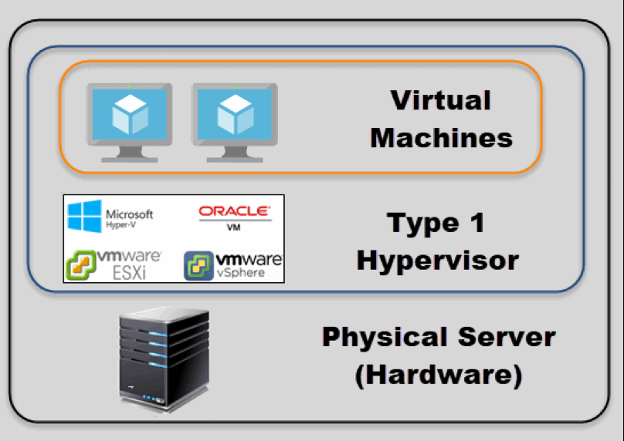
Type 1 Hypervisor

Slide 14
Type 1 Hypervisor
A bare-metal hypervisor (Type 1) is a layer of software we install directly on top of a physical server and its underlying hardware.
There is no software or any operating system in between, hence the name bare-metal hypervisor.
A Type 1 hypervisor is proven in providing excellent performance and stability since it does not run inside Windows or any other operating system.

Slide 15
Type 1 hypervisors are an OS themselves, a very basic one on top of which you can run virtual machines. The physical machine the hypervisor is running on serves virtualization purposes only. You cannot use it for anything else.
Type 1 hypervisors are mainly found in enterprise environments.

Slide 16
Hypervisor Type 1 Performance
Given that type 1 hypervisors are relatively simple, they do not offer many functionalities
Once you boot up a physical server with a bare-metal hypervisor installed, it displays a command prompt-like screen.

Slide 17
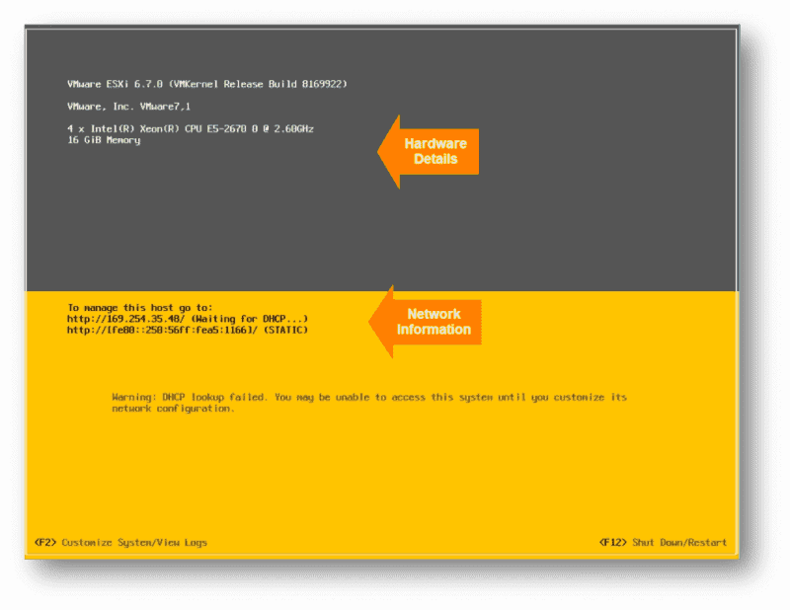
Example of a VMware type 1 hypervisor’s screen after the server boots up

Slide 18
Another type 1 hypervisor may look quite different but they also only allow for simple server configuration.
This consists of changing the date and time, IP address, password, etc.
In order to create virtual instances, you need a management console set up on another machine.
Using the console, you can connect to the hypervisor on the server, and manage your virtual environment.

Slide 19
A management console can be web-based or a separate software package you install on the machine for which you want remote management.
Depending on what functionalities you need, the license cost for management consoles varies substantially.

Slide 20
VM Migration
One action you can perform includes moving virtual machines between physical servers, manually or automatically.
This move is based on resource needs of a VM at a given moment and happens without any impact to the end-users.
It’s the same process if a piece of hardware or a whole server fails.

Slide 21
One of the best features of type 1 hypervisors is that they allow for over-allocation of physical resources.
With type 1 hypervisors, you can assign more resources to your virtual machines than you have available.
For example, if you have 128GB of RAM on your server and eight virtual machines, you can assign 24GB of RAM to each of them. This totals to 192GB of RAM, but VMs themselves will not actually consume all 24GB from the physical server.
The VMs think they have 24GB when in reality they only use the amount of RAM they need to perform particular tasks.

Slide 22
Type 1 Vendors
There are many different hypervisor vendors available. Most provide trial periods to test out their services before you buy them.
The licensing costs can be high if you want all the bells and whistles they have to offer.
VMware ESX and ESXi
KVM
Microsoft Hyper-V
Citrix XenServer
Oracle VM

Slide 23
VMware ESX and ESXi
These hypervisors offer advanced features and scalability, but require licensing, so the costs are higher.
There are some lower-cost bundles that VMware offers and they can make hypervisor technology more affordable for small infrastructures.
VMware is the leader in the Type-1 hypervisors. Their vSphere/ESXi product is available in a free edition and 5 commercial editions.

Slide 24
KVM (Kernel-Based Virtual Machine)
KVM is built into Linux as an added functionality. It lets you convert the Linux kernel into a hypervisor.
It is sometimes confused with a type 2 hypervisor
It has direct access to hardware along with virtual machines it hosts.
KVM is an open-source hypervisor that contains all the features of Linux with the addition of many other functionalities. This makes it one of the top choices for enterprise environments.
Some of the highlights include live migration, scheduling and resource control

Slide 25
Microsoft Hyper-V
The Microsoft hypervisor, Hyper-V doesn’t offer many of the advanced features that VMware’s products provide. However, with XenServer and vSphere, Hyper-V is one of the top 3 Type-1 hypervisors.
It was first released with Windows Server, but now Hyper-V has been greatly enhanced with Windows Server 2012
Hyper-V is available in both a free edition (with no GUI) and 4 commercial editions
Hyper-V may not offer as many features as VMware vSphere package, but you still get live migration, replication of virtual machines, dynamic memory and many other features.

Slide 26
Oracle VM
This hypervisor has open-source Xen at its core and is free.
Advanced features are only available in paid versions.
Even though Oracle VM is essentially a stable product, it is not as robust as vSphere, KVM or Hyper-V.

Slide 27
Citrix Hypervisor (formerly known as Xen Server)
It began as an open source project.
This Server virtualization platform by Citrix is best suited for enterprise environments. It can handle all types of workloads and provides features for the most demanding tasks. Citrix is proud of its proprietary features, such as Intel and NVIDIA enhanced virtualized graphics

Slide 28
Type 2 Hypervisor
This type of hypervisor runs inside of an operating system of a physical host machine.
This is why we call type 2 hypervisors – hosted hypervisors.
As opposed to type 1 hypervisors that run directly on the hardware, hosted hypervisors have one software layer underneath. In this case we have:
A physical machine.
An operating system installed on the hardware (Windows, Linux, macOS).
A type 2 hypervisor software within that operating system.
The actual instances of guest virtual machines.

Slide 29
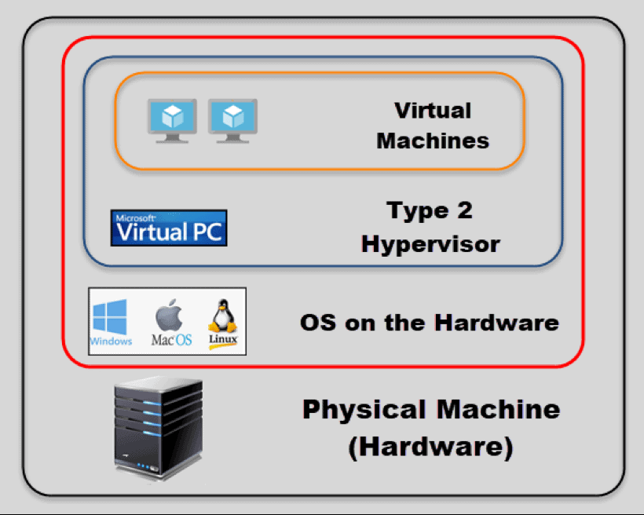

Slide 30
Type 2 hypervisors are typically found in environments with a small number of servers.
What makes them convenient is that you do not need a management console on another machine to set up and manage virtual machines.
They are not any different from the other applications you have in your operating system.

Slide 31
Hypervisor Type 2 Performance
Hosted hypervisors essentially also act as management consoles for virtual machines, you can perform any task using the built-in functionalities.
There is no need to install separate software on another machine to create and maintain your virtual environment.

Slide 32
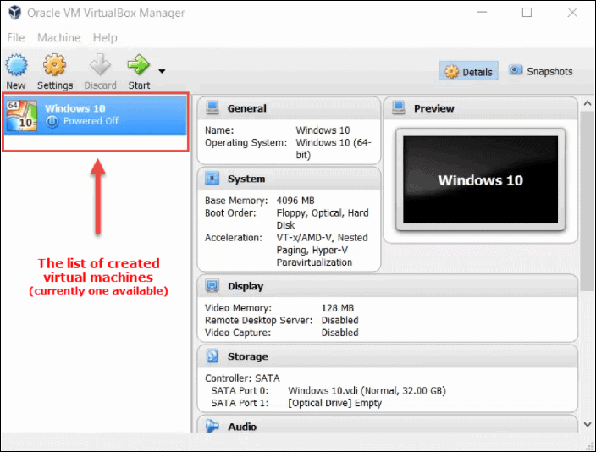

Slide 33
You do need to be careful when allocating actual resources with this type of hypervisor.
Bare-metal hypervisors can dynamically allocate available resources depending on the current needs of a particular VM.
A type 2 hypervisor occupies whatever you allocate to a virtual machine.

Slide 34
When you assign 8GB of RAM to a VM, that amount will be taken up even if the VM is using only a fraction of it.
If the host machine has 32GB of RAM and you create three VMs with 8GB each, you are left with 8GB of RAM to keep the physical machine running.
Creating another VM with 8GB of ram would bring down your system. This is critical to keep in mind, so as to avoid over-allocating resources and crashing the host machine.

Slide 35
Type 2 hypervisors are convenient for testing new software and research projects.
It is possible to use one physical machine to run multiple instances with different operating systems to test how an application behaves in each environment or to create a specific network environment.
You only need to make sure that there are enough physical resources to keep both the host and the virtual machines running.

Slide 36
Type 2 Vendors
Many type 2 hypervisors are free in their basic versions and provide sufficient functionalities.
Some even provide advanced features and performance boosts when you install add-on packages, free of charge

Slide 37
Oracle VM VirtualBox
A free but stable product with enough features for personal use or smaller businesses.
VirtualBox is not resource demanding, and it has proven to be a good solution for both desktop and server virtualization.

Slide 38
VMware Workstation Pro/VMware Fusion
VMware Workstation Pro is a type 2 hypervisor for Windows OS.
it is full of advanced features and has seamless integration which allows you to move your apps between desktop and cloud environments.
It does come with a price tag, as there is no free version. If you want to take a glimpse into VMware hosted hypervisors free of charge, you can try VMware Workstation Player. This is the basic version of the hypervisor suitable for small sandbox environments.
For MacOS users, VMware has developed Fusion that is similar to their Workstation product. It comes with somewhat fewer features, but also carries a smaller price tag.

Slide 39
Type 1 vs. Type 2 Hypervisors
The first thing you need to keep in mind is the size of the virtual environment you intend to run.
For personal use and smaller deployments, you can go for one of the type 2 hypervisors.
If budget is not an issue, VMware will provide every feature you need.
Otherwise, Oracle VM VirtualBox is a hypervisor that will provide most of the functionalities generally needed.

Slide 40
Enterprise Environments
Even though type 1 hypervisors are the way to go, you do need to take into consideration many factors before making a decision.
The critical factor is usually the licensing cost. This is where you need to pay extra attention since licensing may be per server, per CPU or sometimes even per core.
In the current market, there is a battle going on between VMware vSphere and Microsoft Hyper-V.
While Hyper-V was falling behind a few years ago, it has now become a valid choice, even for larger deployments.

Slide 41
Many vendors offer multiple products and layers of licenses to accommodate any organization.
You may want to create a list of the requirements.
Such as, how many VMs you need, maximum allowed resources per VM, nodes per cluster, specific functionalities, and then check which of these products best fits your needs.

Slide 42
Virtual Machines
VMs are created from Physical Machines, to enhance resource sharing, and improve computer performance in terms of resource utilization
Multiple virtual machines (VMs) are multiplexed in the same hardware machine
Hardware resources (CPU, memory, I/O devices, etc.) or software resources (operating system and software libraries) can be virtualized in various functional layers

Slide 43
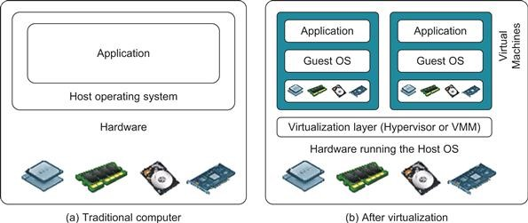
Architecture of Computer System Before and After Virtualization

Slide 44
A traditional computer runs with a host operating system specially tailored for its hardware architecture
After virtualization, different user applications managed by their own operating systems (guest OS) can run on the same hardware, independent of the host OS.
This is often done by adding additional software, called a virtualization layer — Hypervisor/ Virtual Machine Manager (VMM)
The VMs are shown(previous slide) , where applications run with their own guest OS over the virtualized CPU, memory, and I/O resources
The virtualization software creates the abstraction of VMs by interposing a virtualization layer at various levels of a computer system
Common virtualization layers include the instruction set architecture (ISA) level, hardware level, operating system level, library support level virtualization

Slide 45
Virtualization Levels
Instruction Set Architecture Level (ISA) Hardware Abstraction Level (HAL)
Operating System Level
Library-level virtualization

Slide 46
Instruction Set Architecture Level (ISA)
Instruction set virtualization enables the running of applications and virtual machines designed for one processor to run on other processors with different instruction set architectures

Slide 47
Activity happenings within the Instruction Set Architecture Level (ISA)
Instruction set
The hardware on the physical server in cloud computing has its own instruction set that it will process.
Emulator
The emulator serves as an interpreter, and the fundamental role of this is to set communication between the virtualization and hardware layers in cloud computing

Slide 48
Mapping of the instruction
Instructions that the emulator gets for the resources from the virtual machine can get mapped to the hardware instruction presented in the host machine.
Therefore, after the processing emulator got the result back from the host machine, it sent services to the user with the help of the virtual machine

Slide 49
Hardware Abstraction Level (HAL)
Hardware-Abstraction level virtualization is available right on top of the bare hardware. On the one side, this approach produces a virtual hardware environment for a VM.
On the other side, the process controls the underlying hardware through virtualization.
Therefore, the purpose is to virtualize computer resources, such as processors, memory, and I/O devices.

Slide 50
Hardware resources in the host machine get mapped using a virtualization layer to the virtual resources present on the guest operating system.
Hence, virtualized computing system holds thousands of resources. All of them need some directions for processing, which is not an easy task. And due to, this instruction was classified into two primary forms to make the processing smooth
Non-privileged instruction– These instructions execute directly without interfering with other tasks.
Privileged instruction– These instructions require some modification before it executes.

Slide 51
Operating System Level
Operating system based Virtualization refers to an operating system feature in which the kernel enables the existence of various isolated user-space instances.
The installation of virtualization software also refers to Operating system-based virtualization. It is installed over a pre-existing operating system and that operating system is called the host operating system.

Slide 52
In this virtualization, a user installs the virtualization software in the operating system of his physical machine like any other program and utilize this application to operate and generate various virtual machines.
Here, the virtualization software allows direct access to any of the created virtual machine to the user.

Slide 53
Library-level virtualization
Library-level virtualization is also known as API emulation
This type of virtualization can create execution environments for running alien programs on a platform rather than creating a VM to run the entire operating system.

Slide 54
